Slide 1

AIRBNB’S IN EUROPE
A PRESENTATION ON THE NEXT BEST CITY TO EXPAND TO DONE BY NDUTA MAINA

Slide 2

AGENDA
Introduction
Background
Analysis Questions
Conclusion

Slide 3

introduction
BUSINESS PROBLEM:
A travel business that specializes in planning curated trips for long-term stays, primarily utilizing Airbnb properties, is looking to expand its operations to a new European city. The agency is evaluating Amsterdam, Berlin, and Lisbon as potential markets for expansion. The key objective is to determine which city offers the most favorable conditions for their business, specifically in terms of market trends related to Airbnb demand, supply, pricing, and regulations. Additionally, the business aims to identify the city with the highest marketing potential to attract clients.
The main business problem is to analyze these cities and decide which one provides the optimal balance of Airbnb growth, competitive pricing, and regulatory environment to support sustainable business expansion and effective marketing strategies.
.

Slide 4
Background on analysis
Data source, metadata and queries made

Slide 5
Data source & META DATA
DATA: AIRBNB’S IN EUROPE (FOR KAGGLE)
This dataset provides a comprehensive analysis of Airbnb prices in several popular European cities. Each listing is assessed based on various attributes such as room type, cleanliness, guest satisfaction ratings, number of bedrooms, distance from the city center, and more, to offer an in-depth understanding of Airbnb pricing on both weekdays and weekends. By applying spatial econometric methods, the dataset identifies the key determinants of Airbnb prices across these cities. It includes data such as *realSum* (the total price of the listing), *room_type* (private/shared/entire home/apt), guest_satisfaction_overall* (the overall rating from guests comparing all listings offered by a host), number of bedrooms, *dist* (distance from the city center
**I EXTRACTED ONLY THE 3 CITIES
The aim is to provide insights into how global markets are influenced by social dynamics and geographical factors, which in turn impact pricing strategies for optimal profitability.

Slide 6
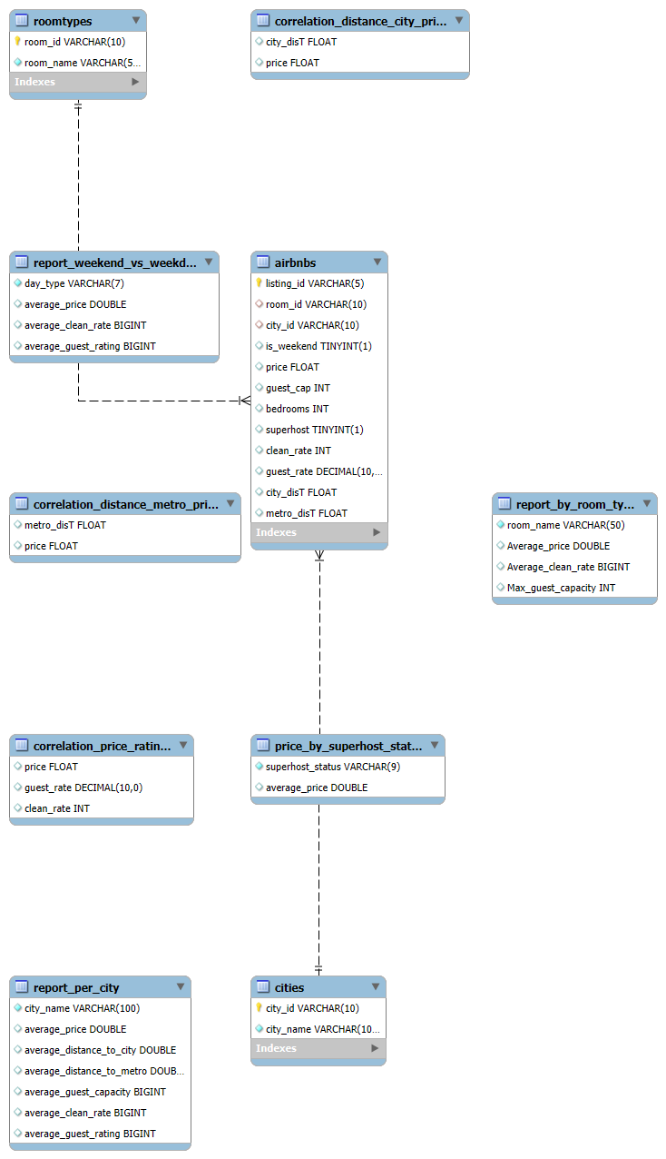
QUERIES PERFORMED ON THE DATA

Slide 7


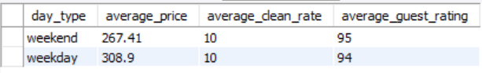
ANALYSIS QUESTIONS
What are the key characteristics and performance metrics of Airbnb properties in Amsterdam, Berlin, and Lisbon, and how do these factors compare across the three cities?
How do Airbnb prices, cleanliness ratings, and guest satisfaction ratings vary between weekdays and weekends?“

Slide 8
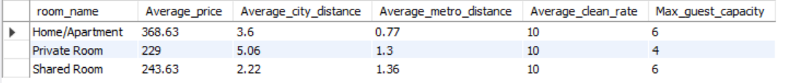
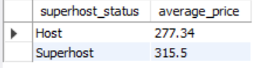
What are the key characteristics and performance metrics of the three room types and how do these factors compare across the three cities?
How does the Superhost status of Airbnb hosts impact the average pricing of their properties?

Slide 9
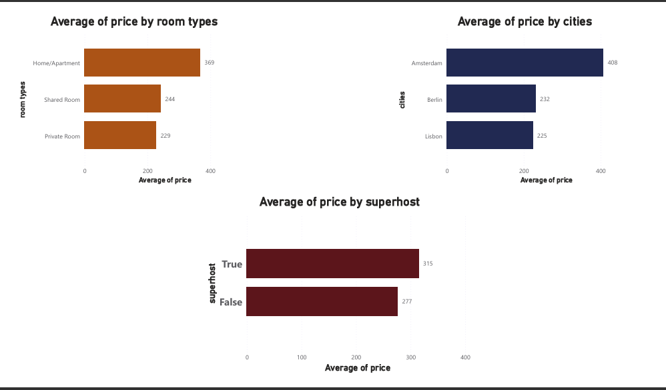

Slide 10
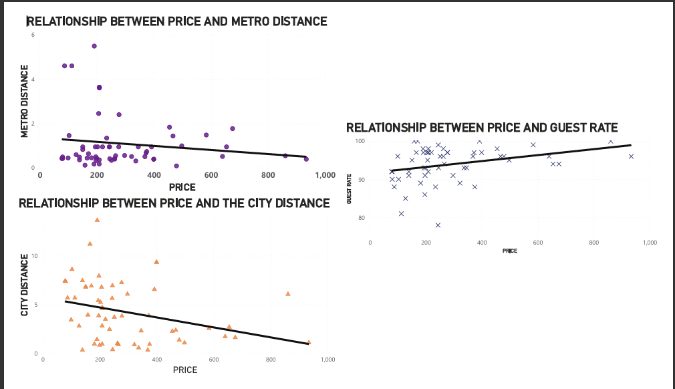
Relationships with price

Slide 11
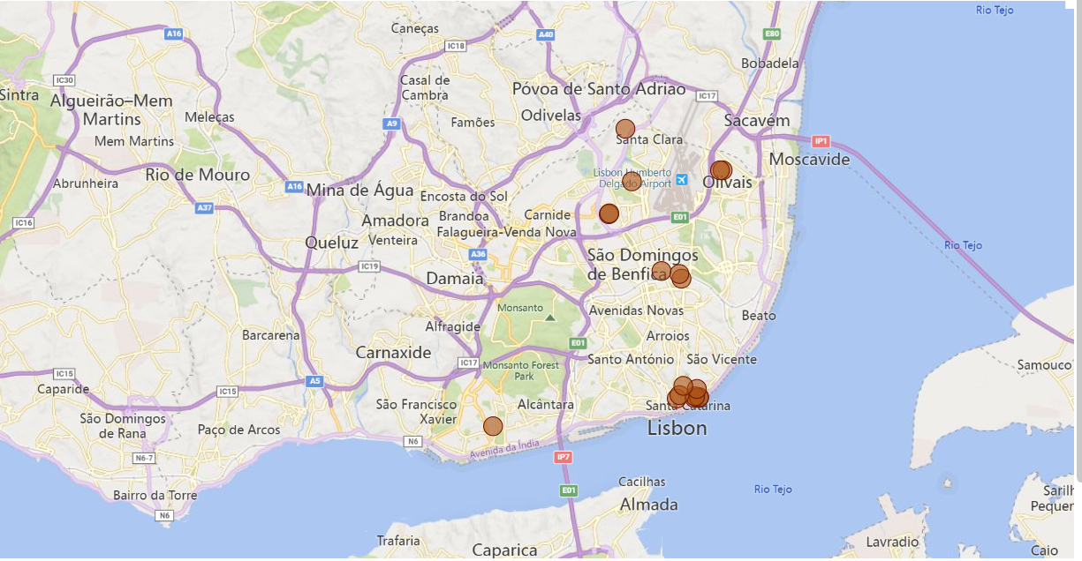
MAPPINGS IN LISBON

Slide 12
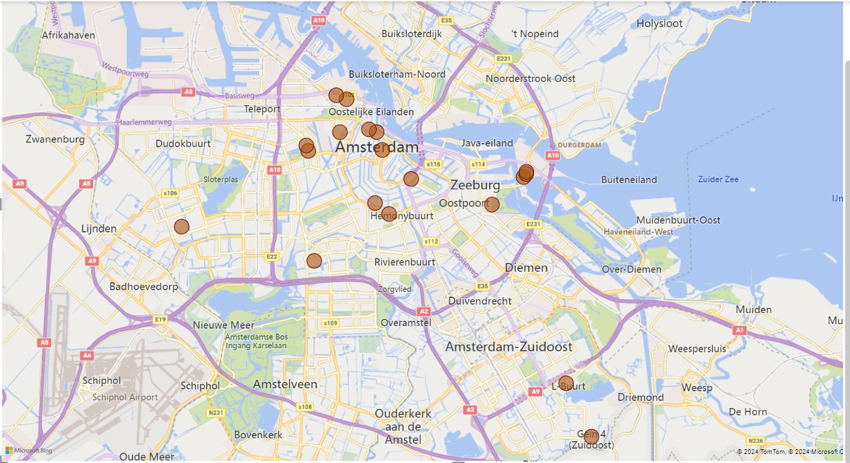
MAPPINGS IN Amsterdam

Slide 13
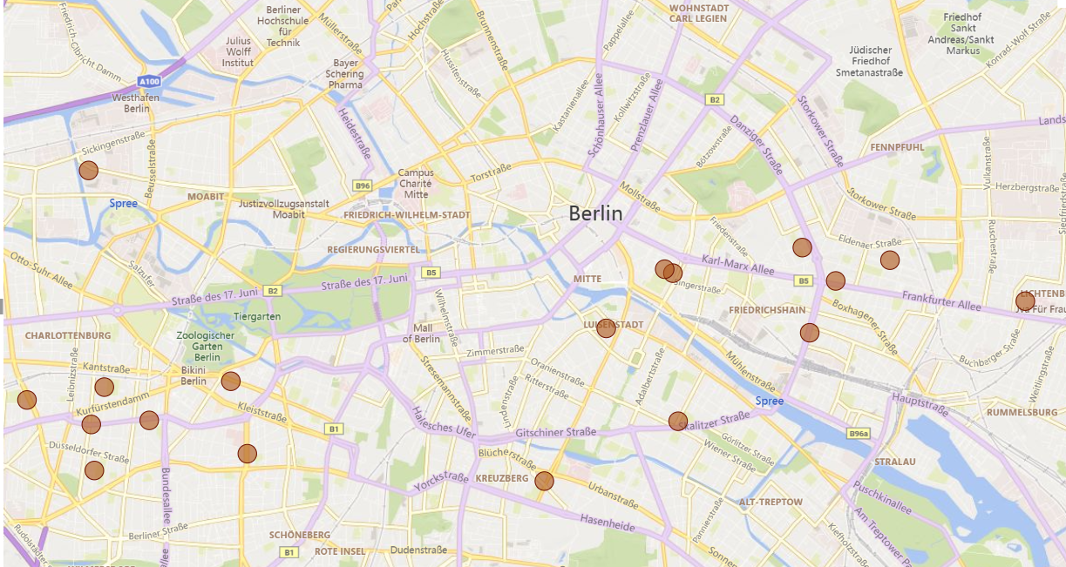
MAPPINGS IN BERLIN

Slide 14
CONCLUSION
Some insights from the analysis include:
Weekday prices tend to be higher than weekend prices, possibly due to lower demand during weekdays, prompting hosts to charge more when they do secure bookings.
Properties managed by Super hosts typically command higher prices than those managed by regular hosts.
Homes or apartments are the most expensive room types, despite having a similar guest capacity as shared rooms. This suggests that other factors, such as privacy or amenities, may drive the price difference.
The relationship between price and metro distance appears to be positive, meaning the closer a property is to a metro station, the lower the price. However, the relationship between price and city center distance is weak or nearly nonexistent.
Guest satisfaction tends to be higher when properties are more affordable, indicating that guests rate their experiences more positively when they perceive value for money.
Berlin Airbnb's tend to be located around the mainland while Amsterdam and Lisbon tend to be closer to the beach, this could be due to different tourist attraction sites.
These insights will assist the travel agency in identifying key marketing areas and making strategic decisions for their expansion.

Slide 15
CONCLUSION
To determine the best city for expansion and marketing, the travel agency should consider key factors such as the average price of Airbnb properties and the elements that influence it, like superhost status, room type, guest satisfaction, cleanliness, and proximity to the city center or metro.
Based on my analysis, Lisbon is the most favorable city for expansion. It has the lowest average price, and most Airbnb properties are conveniently located near metro stations or the city center compared to other cities. Lisbon also boasts the highest guest capacity, and both its cleanliness and guest satisfaction ratings are excellent.

Slide 16
CONCLUSION
The analysis has several limitations that should be acknowledged.
Firstly, while there are numerous cities in Europe to compare, this study focused solely on Amsterdam, Berlin, and Lisbon. Including more cities could have provided a more comprehensive understanding of market trends.
Additionally, due to the large volume of data for each city, I sampled only 10 properties from each, which may not accurately represent the full population and could limit the generalizability of the findings.
Some variables, such as longitude, latitude, and other repetitive columns, were excluded from the dataset to streamline the analysis, though these variables might have provided valuable spatial insights.
Moreover, as this is a beginner-level analysis, the insights presented are general and likely do not capture the full depth of the data. With more advanced methods, there would likely be a greater range of meaningful insights to uncover.

Slide 17

THANK YOU
NDUTA MAINA
FINAL PROJECT FOR ZIUNDA DATA STORYTELLING 24

